Slide 1
Machine Learning with Python
The Complete Course
TELCOMA

Slide 2
Module 4 Machine Learning

Slide 3
Content:
Introduction to Machine Learning
Supervised Machine Learning [Linear Regression/ Logistic Regression/ Decision Trees]
Unsupervised Machine Learning [Clustering/Association]
Evaluating Machine Learning models
Regularization and Hyperparameter tuning
Ensemble Modelling [Bagging/Boosting]

Slide 4
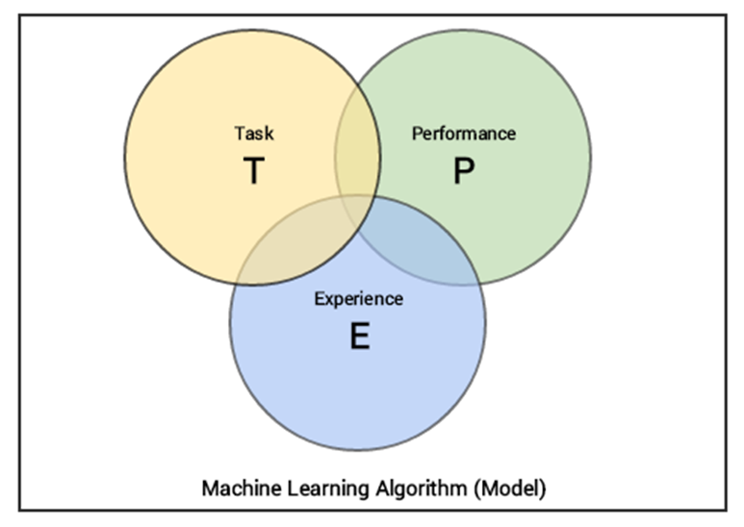
Introduction to Machine Learning
Definition
The art of making machines intelligent without explicit programming
Machine learning is a field which consists of learning algorithms or techniques which
execute some task T (Regression/Classification)
Improve their performance P (model performance)
with experience E (Data)

Slide 5
Introduction contd…
Building Machine learning models is a 3 stage process
Representation (selection of an algorithm/parameters)
Evaluation (objective function)
Optimization (finding the optimal parameters)
Types of Machine Learning techniques
Supervised Machine Learning
Unsupervised Machine Learning
Training is done using labelled data
Algorithm learns the mapping function from the input to the output. Y = f(X)
Training is done using unlabelled data
Algorithms are left to their own devises to discover and present the interesting structure in the data.
Examples
Regression - used to predict continuous values
Classification - used to predict categorical values
Examples
Clustering – used to discover the inherent groupings in the data
Association - used to discover rules that describe large portions of the data

Slide 6
Supervised Learning

Slide 7
Supervised M/L – Regression
Definition
Regression is the technique that determines the relationship between one or more independent variables and a dependent variable
Few other naming styles
Dependent : Independent
Target : Input
Criterion : Predictor
Linear
Simple Linear Regression
Only one independent variable
Multiple Linear Regression
Two or more independent variable
Non Linear Regression
Dependent on non-linear transformation of independent variables

Slide 8
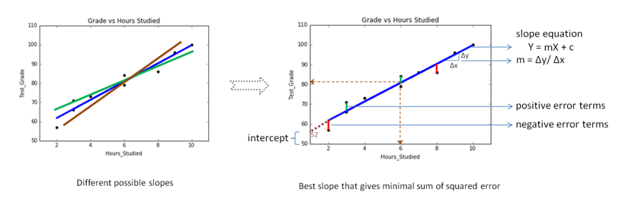
Simple Linear Regression
In Simple Linear Regression, we fit the best line between the dependent variable and the independent variable given as y = mx + c
m = Co-efficient of x (i.e. change in y divided by change in x)
C = intercept (represents the variability in y, unexplained by x)
Few points to wander-
How is the best line calculated?
- OLS
Why not use just correlation?
- Intercept

Slide 9
Multiple Linear Regression
Real life scenarios will definitely have many more independent variables than just 1
To model an equation that studies the relationship between the dependent variable and multiple independent variables
The representation equation can be extended to
y = m0 + m1 x1 + m2 x2 + m3 x3 + . . .+ mn xn
Where
- m0 is the intercept
- m1 is the coefficient of variable x1
- m2 is the coefficient of variable x2
and so on…..

Slide 10
Demo Simple & Multiple Linear Regression Data - https://archive.ics.uci.edu/ml/datasets/bike+sharing+dataset

Slide 11
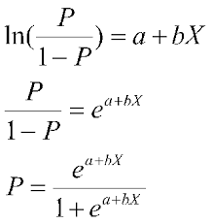

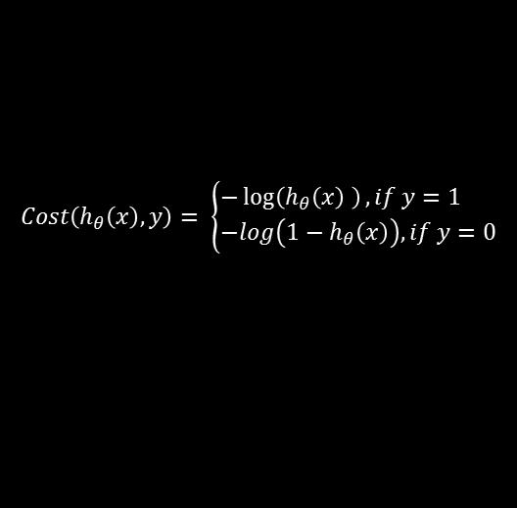
Supervised M/L – Classification
Logistic Regression
On the same definition for regression, Logistic regression is a technique that determines the relationship between a dependent variable and one or more independent variable, with the type of dependent being a dichotomous categorical variable.
$$Cost\left(h_{θ}\left(x\right),y\right)= \left\{\begin{aligned}&−\log\left(h_{θ}\left(x\right) \right), if y=1 \\ &−log\left(1−h_{θ}\left(x\right)\right), if y=0\end{aligned}\right.$$
$$\left.Cost\left(θ\right)=l(θ)= \sum_{i=1}^{m}{y^{i}log{(}h\left(x^{i}\right))+(1−y^{i})log{(}1−}h\left(x^{i}\right)\right)$$
To maximize or minimize a fn, we differentiate the function and and find the point where the Gradient is 0
Since, this is a non linear function, we use the gradient descent i.e. calculate the gradient of the fn at each point we want to optimize and move In the direction of negative descent
i.e. update the values of parameters

Slide 12
Demo Logistic Regression Data – HR Analytic (Kaggle)

Slide 13
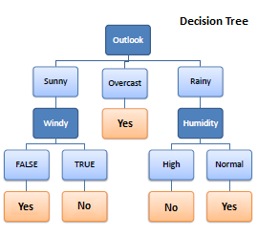
Supervised ML - Decision Trees
Definition
Decision Trees are a class of Supervised Learning Algorithms which can be used for predicting categorical or continuous variables
How does it work?
It works by breaking data from the root node into smaller and smaller subsets while incrementally building associated decision tree.
The final result is a tree with a root node, decision nodes and leaf nodes.
Decision nodes create a rule and leaf nodes deliver a result

Slide 14
Types of Decision Trees
Decision Trees
Classification
Regression
ID3
CART
C4.5
And a few more…

Slide 15
Building Decision Trees
Pseudocode
Few questions?
1) Select Root Node
How to select the Root Node?
How are the decision nodes ordered/chosen?
When does the branching stop?
How does the tree treat continuous variables?
How different is the process for classification and Regression?
2) Partition Data into respective groups
3) Create a Decision node
4) Partition Data into respective groups
Repeat until the node size > threshold or Features = empty

Slide 16
Entropy
What is it?
Entropy (measures the homogeneity of the sample)
-pLogp – qLogq (base 2)
Where p = Probability of event happening
q = probability of event not happening
How is it done?
Entropy(Employee,Dress-code)
Prob(Formals) * Entropy_formals +
Prob(Casuals) * Entropy_casuals +
Prob(BCasuals) * Entropy_Bcasuals
(14/61) * Entropy(6,8) +
(35/61) * Entropy(31,4) +
(12/61) * Entropy(9,3)
= 0.68
Gain(Emp) =
Entropy(Emp) – Entropy(DressCode, Emp)
= 0.80 – 0.69 = 0.11
Consider the problem of
Predicting whether the Employee is a Techie or a Non-Techie?
Entropy(Emp) : Entropy(Techie,Non-Techie)
Entropy(46,15) -pLogp – qLogq : -0.75Log(0.75) -0.25Log(0.25)
= 0.8

Slide 17
Decision Trees - Classification & Regression
Employee is Techie or Non-Techie?
Employee’s average working hrs.?
Dress Code
100 obs.
Dress Code
Casuals
Business Casuals
Formal
Casuals
Business Casuals
Formal
25 obs.
20 obs.
55obs.
Lower Entropy
Lower StdDev
Gender
Techie
Non-Techie
Gender
12
9
Male
Female
Male
Female
32 obs.
23 obs.
Techie
Non-Techie
10
8

Slide 18
Unsupervised Learning

Slide 19
Clustering
The key objective in clustering is to identify distinct groups/clusters)based on some notion of similarity within a given dataset.
Types of clustering
Agglomerative (hierarchical)
Divisive (k – means)
K-Means clustering
Start with random point initialization of the required number of centers. ('K' in K-means stands for the number of clusters)
Assign each data point to the 'center' closest to it. (distance metric := normal Euclidian distance)
Recalculate centers by averaging the dimensions of the points belonging to the cluster.
Repeat with new centers until we reach a point where the assignments become stable.
Hierarchical clustering
Start with n clusters (n = # of datapoints)
Combine the 2 closest clusters
Repeat till only 1 cluster exists

Slide 20
Association Rule Mining
Association rule mining is a procedure to find frequent patterns, correlations, associations, or causal structures from data sets
Algorithm details
Item set – The list of all transactions; {milk, bread}, {apples, oranges}, {milk}
Support - # of times an item appears in a dataset
i.e. support(milk, bread) = (# transactions with milk and bread)/(Total # of transactions)
Confidence – Measure of # of times a rule is found to exist in the dataset
i.e. confidence(milk -> bread) = support(milk and bread)/ support(milk)
Main Applications
- Cross sell/Up-sell
- Market Basket Analysis

Slide 21
Model Evaluation

Slide 22
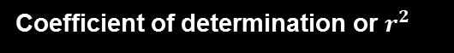
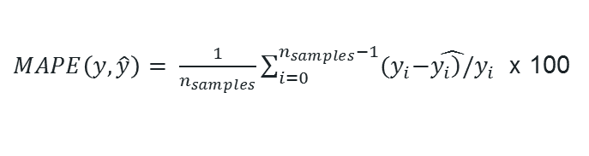


Regression Models
Few more …
Coefficient of determination or $r^{2}$
MAPE - Mean absolute percentage error
$$R^{2}\left(y,\hat{y}\right)=1−\frac{\sum_{i=0}^{n_{samples}−1}{{\left(y_{i}−{\hat{y}}_{i}\right)}^{2}}}{\sum_{i=0}^{n_{samples}−1}{{\left(y_{i}−\overline{y}\right)}^{2}}}$$
$MAPE\left(y,\hat{y}\right)= \frac{1}{n_{samples}}\sum_{i=0}^{n_{samples}−1}{{(y}_{i}−\hat{\left.y_{i}\right)/}y_{i}}$ x 100
RMSE – Root mean squared error
Mean Squared Error
$$MSE\left(y,\hat{y}\right)= \frac{1}{n_{samples}}\sum_{i=0}^{n_{samples}−1}{{\left(y_{i}−\hat{\left.y_{i}\right)}\right.}^{2}}$$

Slide 23
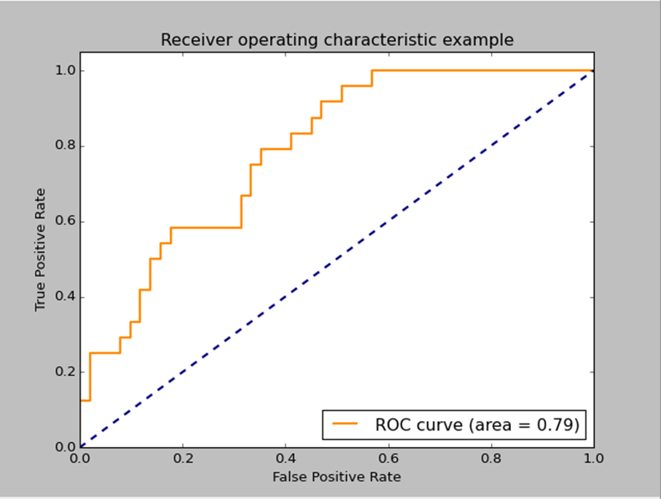




Classification models
ROC Curve
Predicted Classes
0
1
0
True -ve
False -ve
Actual Classes
1
False +ve
True +ve
$$Accuracy= \frac{TP+TN}{TP+FP+TN+FN}$$
$$Precision= \frac{TP}{TP+FP}$$
$$Recall= \frac{TP}{TP+FN}$$
Area under curve
$$F1_Score= \frac{2TP}{2TP+FP+FN}$$

Slide 24
Overfitting, Regularization & Hyperparameter Tuning

Slide 25
A brief introduction
Overfitting
A phenomenon in machine learning when the model gets to complex and fails to generalize.
Regularization
A technique used to reduce overfitting by introducing a penalty that punishes the ML algorithm while letting the parameters get too large/complicated.
Hyperparameters
Hyperparameters are 'meta parameters' which are associated with the learning algorithm. We ca introduce regularization into an algorithm with the help of hyperparameters.
Hyperparameter tuning/optimization
Finding the best candidate values for hyperparameters that generalizes the model for better accuracy

Slide 26
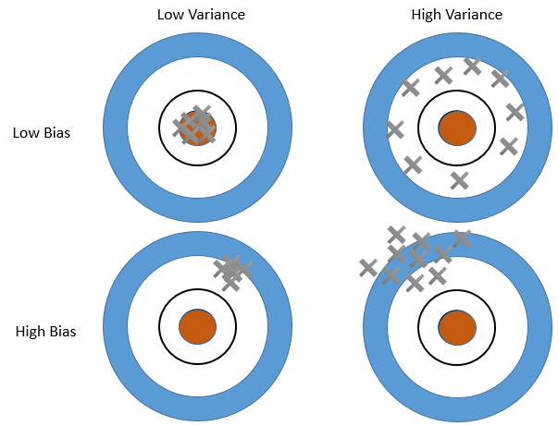
Bias Variance Trade-off
Bias
Is the assumption that the algorithm makes about the structure of the data. It can also be specified as the average approximation error that the model have over all possible training data sets.
Variance
Variance is the sensitivity of the results on a particular set of points
Extreme cases of Bias & Variance
High Bias - Low Variance : Underfitting
Low Bias – High Variance Over fitting

Slide 27
Cross-validation
Model 1
Model 2
Model N
Train’ Set
Whole data
Train set
Validation set
Test set
Error 1
Error 2
Error N
Pick the best model/ or average the error
Different cross validation techniques
K – Fold
2) Leave one out CV

Slide 28
Hyperparameter Tuning
Grid Search
Simplest of the hyperparameter optimization method.
We specify the grid of values (of hyperparameters) that we want to try out.
Models are build on each of the given values, using cross validation and the best parameter combination is selected The output will be the model using the best combination from the grid.
Drawback
The user must supply the list of values for the parameter that may or may not contain the most optimal value
Randomized Search Optimization
Randomized parameter search is a modification to the traditional grid search.
It takes input for grid elements as in normal grid search but it can also take distributions as input.
We control the number of times we want to do the random parameter sampling by specifying the number of iterations we want to run. Normally a higher number of iterations means a more granular parameter search but higher computation time.

Slide 29
Demo

Slide 30
Ensemble Modelling

Slide 31
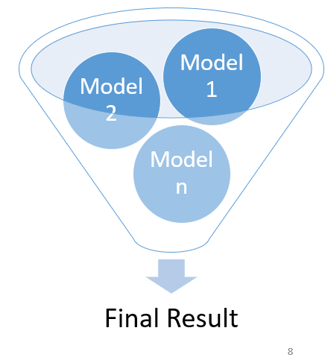
Ensemble Modelling
What is it?
Creating multiple models for the same task and then combining the results into a single value through a weighted or non-weighted method
What kind of models can be used in Ensembles?
-Any kind
What are the different types of Ensembles?
-Bagging, Boosting, Stacking
What are some popular Ensemble modeling techniques?
-Adaboost, Gradient Boosted Machines, Extreme Gradient Boosting, Bagging, Random Forest, Rotation Forest

Slide 32
Random Forest
What is Random Forest?
-An advanced version of Bagging along with feature Randomization
So what is Bagging?
-An ensemble of decision trees with bootstrapping
What can we do with Random Forest?
- Predictive modelling for classification and Regression
What’s different in Random Forest?
More robust in generalization/ regularization, i.e. less prone to overfitting
Less prone to outliers
Relatively easier in tweaking and tuning the model

Slide 33
XGBoost
What is XGBoost
One of the most well performing large-scale, scalable machine learning algorithms developed on the principles of boosting in ensemble modelling
So what is boosting?
-The process building an ensemble of models sequentially where each new model learns from the residue of the previous models
What can we do with XGBoosting
- Predictive modelling for classification and Regression
How is XgBoost different?
It controls overfitting by regularization
Implements parallel processing

Slide 34
Demo

Slide 35
Next Module : Capstone Project

